Slide 1
Innovations in Munitions Response Investigations
Steve Saville
Jacobs
Summer 2023

Slide 2
Disclaimer
This seminar is intended to be informational and does not indicate endorsement of a particular product(s) or technology by the Department of Defense or NAVFAC EXWC, nor should the presentation be construed as reflecting the official policy or position of any of those agencies. Mention of specific product names, vendors, or source or information, trademarks, or manufacturers is for informational purposes only and does not constitute an endorsement or recommendation by the Department of Defense or NAVFAC EXWC. Although every attempt is made to provide reliable and accurate information, there is no warranty or representation as to the accuracy, adequacy, efficiency, or applicability of any product or technology discussed or mentioned during the seminar, including the suitability of any product or technology for a particular purpose.

Slide 3
Presentation Overview
Introduction
Background on MR Technologies
SLAM overview
One-Pass AGC overview
Quality Requirements for MR projects
Conclusions and Useful References
AGC: Advanced Geophysical Classification
MR: munitions response
SLAM: simultaneous localization and mapping

Slide 4


Speaker Introduction
Steve Saville
Geosyntec-Jacobs JV
BS (’99), MS (’07) Geology, PG (’07)
Past 6 years working Navy CLEAN MR
Started in UXO Geophysics in 2001… and never thought MMRP would last this long!
Originally from North Carolina, spent part of childhood across the Chesapeake from Annapolis and has lived in eight states from Hawai’i to Tennessee
Not Pictured: Cats (2), Martha and Mr. Coffee. They prefer it this way.
CLEAN: Comprehensive Long-term Environmental Action—Navy
MMRP: Military Munitions Response Program
PG: Professional Geologist
UXO: unexploded ordnance

Slide 5
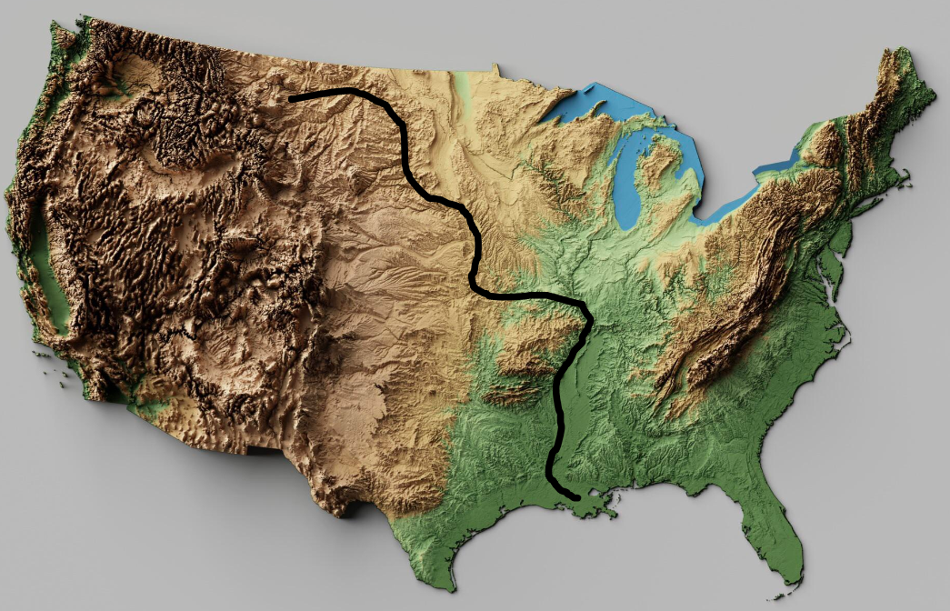
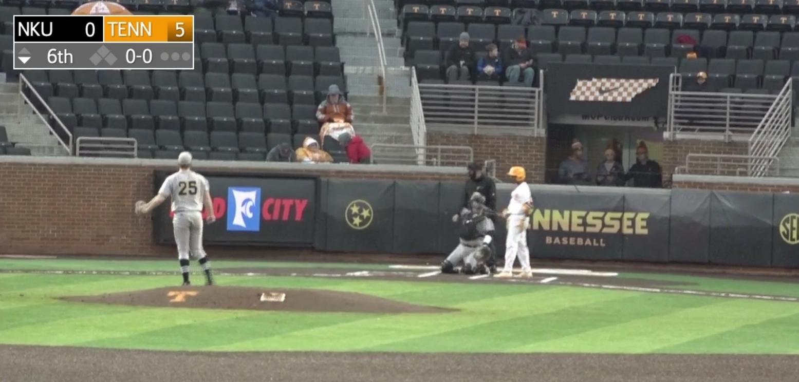
Speaker Introduction
Steve Saville
Fun Facts
  Canoed solo from Montana to
  New Orleans, 2,815 miles,
  97 nights, zero smartphones
  Enjoys all most aspects of baseball… for example, early in the season, in 40°F, with a five-run lead late in the game to a non-conference team
(USGS 2023)
(SEC Network 2019)

Slide 6
Presentation Overview
Introduction
Background on MR Technologies
SLAM overview
One-Pass AGC overview
Quality Requirements for MR projects
Conclusions and Useful References

Slide 7
Background on MR Technologies
Problem statements
MEC is an acute and potentially lethal hazard
MEC may be present in subsurface for decades, requiring management or remediation of site
Geophysical tools can detect and classify subsurface metallic objects, but:
  Accurate positional data are needed (Part 1 of this presentation)
  Most subsurface metallic objects are not munitions-related (Part 2)
MEC: munitions and explosives of concern
Background on MR Technologies
Notes:
MEC should be put in context with regards to munitions items in general. While MEC is the hazard, munitions items (MPPEH) in general can generate actions for DoD.

Slide 8
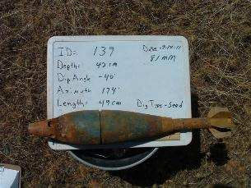
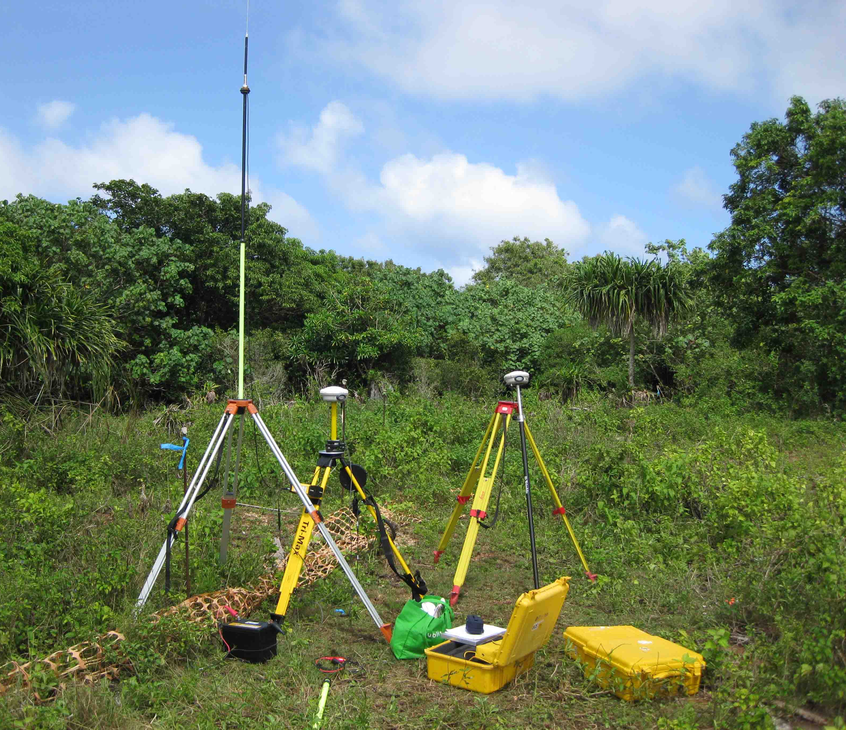
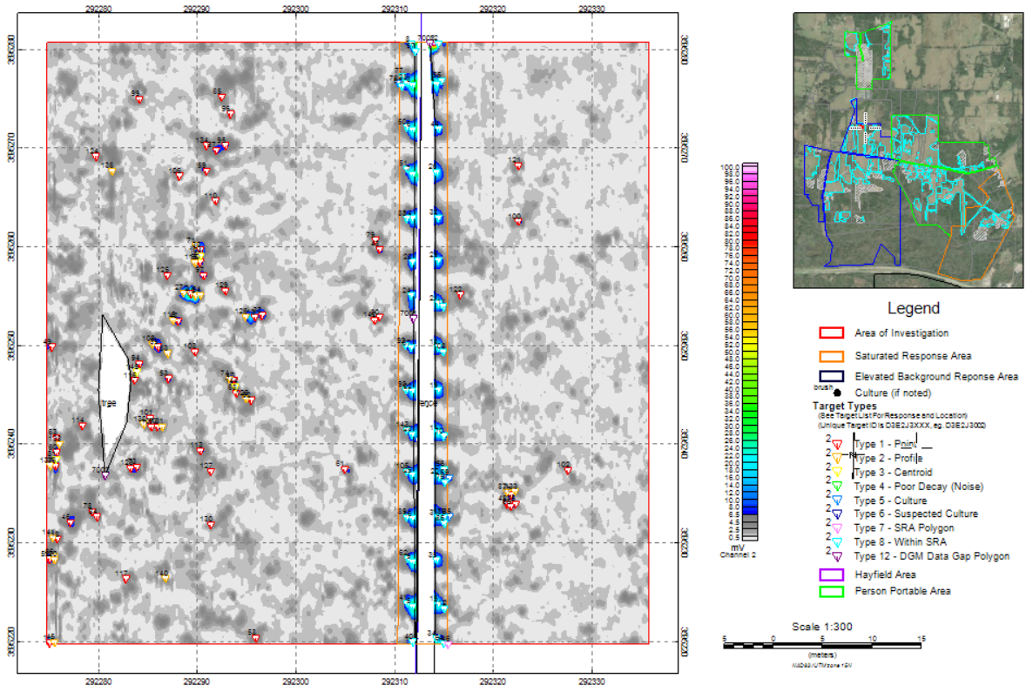
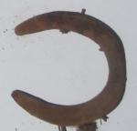
MR Technologies and their Objectives
Positioning
Detection
Advanced Geophysical Classification
(USACE 2021)
(USACE 2020)
Background on MR Technologies

Slide 9
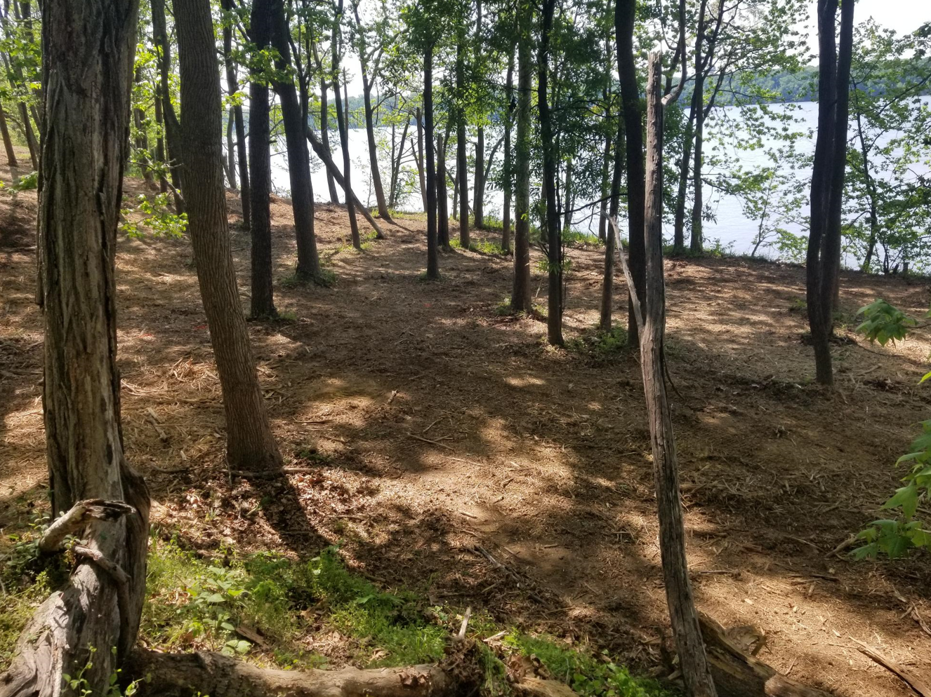
MR Technologies and their Objectives
Positioning – we must be able to know where things are
  GPS
    DGPS – lower accuracy than MR requirements
    RTK – standard for MR geophysical surveys
  What about where GPS does not work
    Fiducial – lowest accuracy
    Robotic Total Station
      Accuracy on par with RTK
      Less efficient than RTK
    SLAM
DGPS: differential Global Positioning System
GPS: Global Positioning System
RTK: real-time kinematic
(Jacobs 2023)
Background on MR Technologies
Notes:
RTS: dropouts and “shadows” occur behind trees and other obstructions

Slide 10
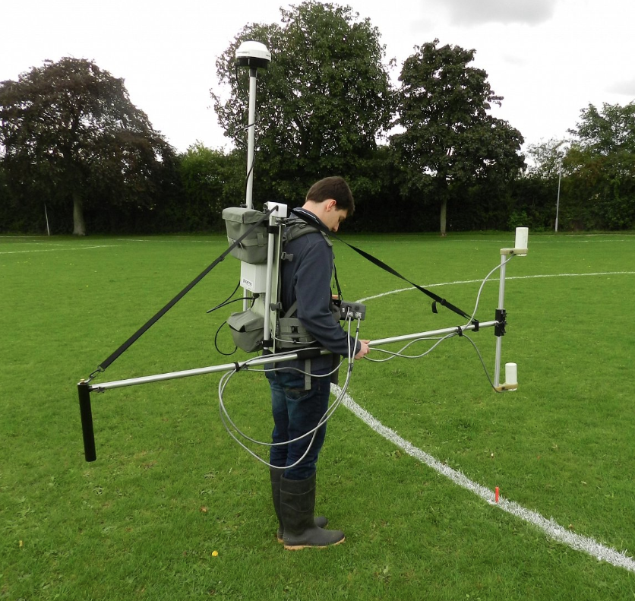
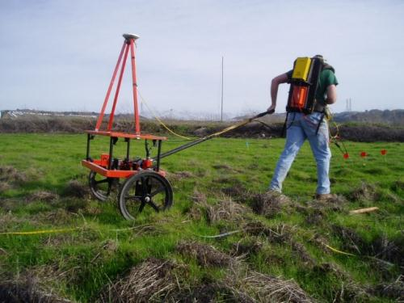
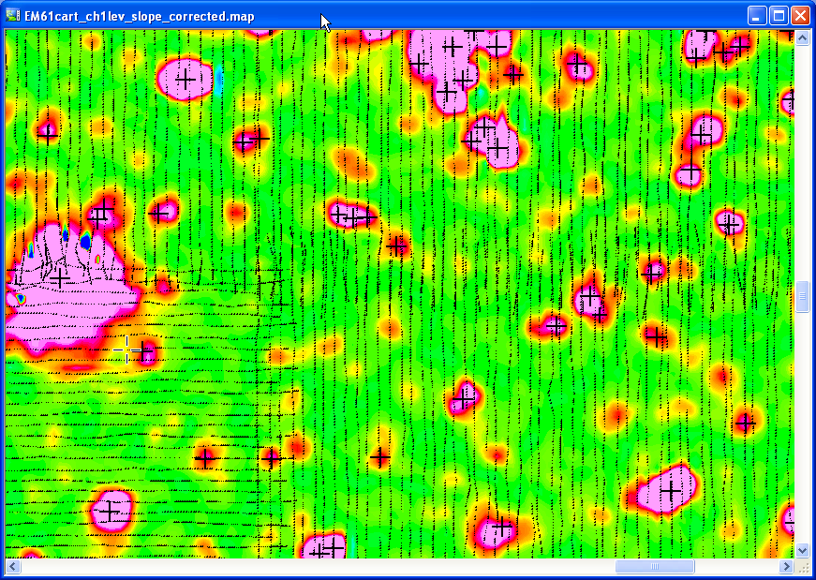
MR Technologies and their Objectives
Detection – find the metal
  Magnetometers (but only ferrous metal)
  Electromagnetic induction sensors (all metals)
(Geomatrix 2023)
(Jacobs 2023)
(Jacobs 2023)
Background on MR Technologies
Notes:
These are the first widely used digital tools for UXO detection, pre-dating the establishment of MMRP in 2001.
Magnetometers were the instruments of choice in the 1990s, then the EM61 (center) became heavily used beginning around 2000. Multi-axis AGC sensors were in development in the mid-2000s and were ready for contractor demonstrations circa 2010.

Slide 11
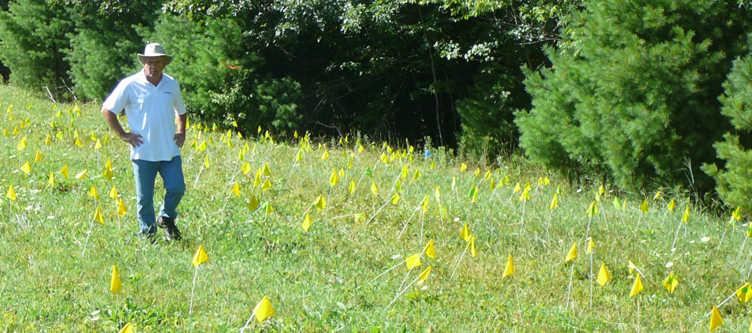
MR Technologies and their Objectives
Classification – focus on the munitions
  As we covered, most subsurface metallic objects are not munitions related
(Jacobs 2023)
Background on MR Technologies

Slide 12
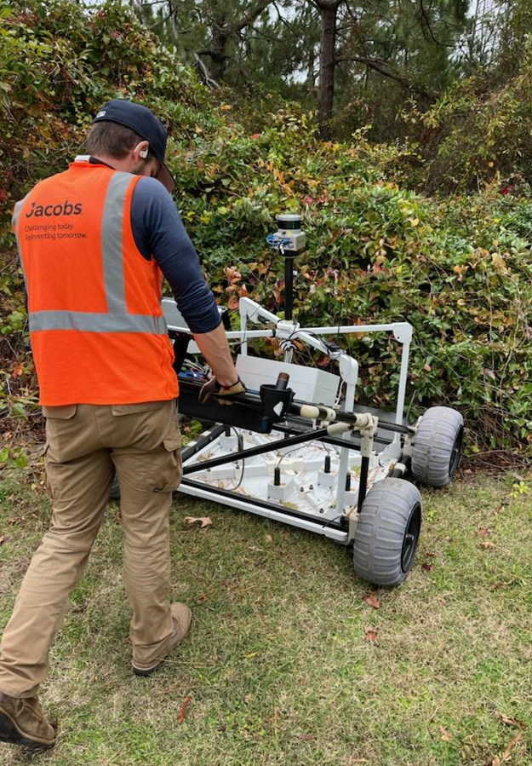
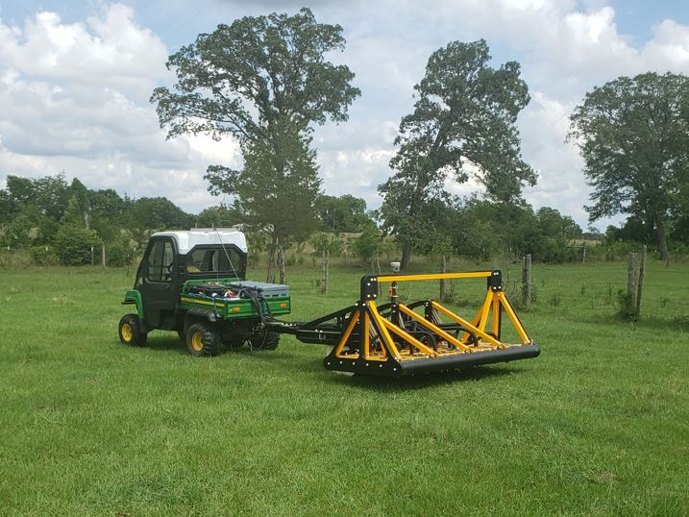
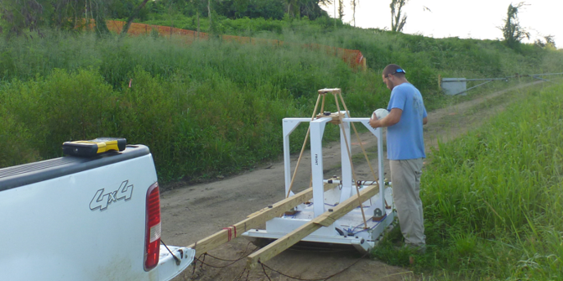
MR Technologies and their Objectives
Classification – focus on the munitions
  AGC uses advanced sensors to collect a tremendous amount of data, then software to invert data to identify source(s) – that is, tangible objects – most likely to have caused the measured data
(Jacobs 2023)
(Jacobs 2023)
(Jacobs 2023)
Background on MR Technologies
Notes:
Inversion = mathematical process to identify the cause(s) behind measured data

Slide 13
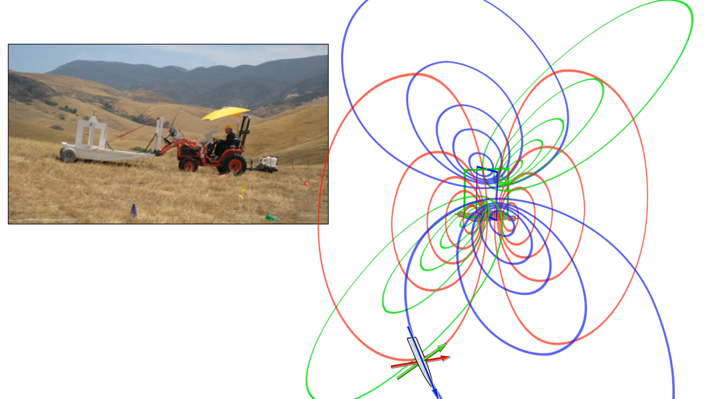
AGC Data Collection in One Slide
What are advanced sensors? What is “multi-axis EM”?
EM: electromagnetic
mV/A: millivolt(s) per amp
ms: millisecond(s)
(NAVFAC EXWC 2023)
Background on MR Technologies
Notes:
Dated video. For general illustration only. Subsurface sources can be illuminated from multiple axes (Z transmitter not solely responsible for deriving one/all polarizability). All received data are assembled/inverted to solve for source(s) location, depth, and polarizabilities. There are more time gates in AGC sensors than EM61 and response data are recorded in three dimensions (vice one with the EM61).

Slide 14
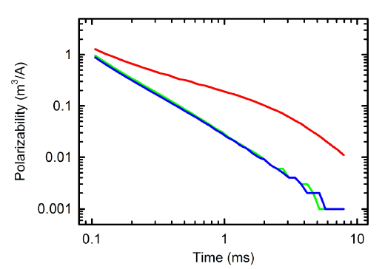
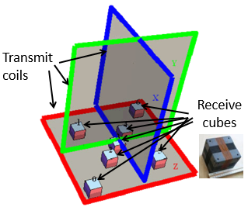
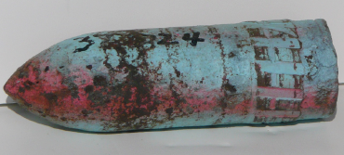
AGC Data Analyses in One Slide
Same physics as DGM
Specifically designed for munitions classification
Interrogates subsurface object from all directions
Now we can isolate intrinsic features useful for classification (answer independent of location)
Polarizability Property | Target Property
Decay Rate | Wall Thickness
Relative Magnitude | Shape
Total Magnitude | Size (Volume)
DGM: digital geophysical mapping
(Jacobs 2023)
Background on MR Technologies
Notes:
AGC is not viable at all sites. High densities of metal objects in the subsurface (e.g., trash pits) and high geologic response (e.g., highly conductive soil) reduce ability to resolve and correctly classify objects.
Decay=slope of curves. Steeper slope = thinner wall.
Relationship of curves = shape. 1=2=3: sphere. 1=2>3: disc. 1>2=3: cylinder.
Y-intercept, y-values = size.

Slide 15
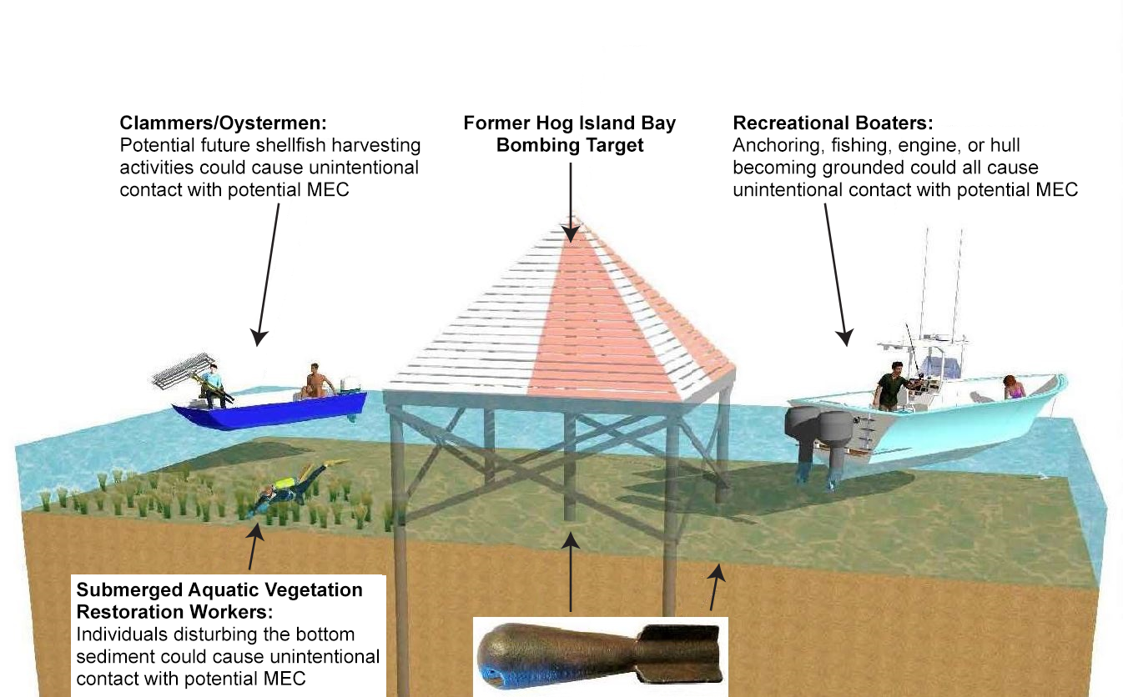
Background on MR Technologies
Along with intrusive data, these technologies advance the CSM
CSM: conceptual site model
(Jacobs 2023)
Background on MR Technologies
Notes:
CSM is putting the investigation’s purpose and data into context of the risks to humans and the environmental.

Slide 16
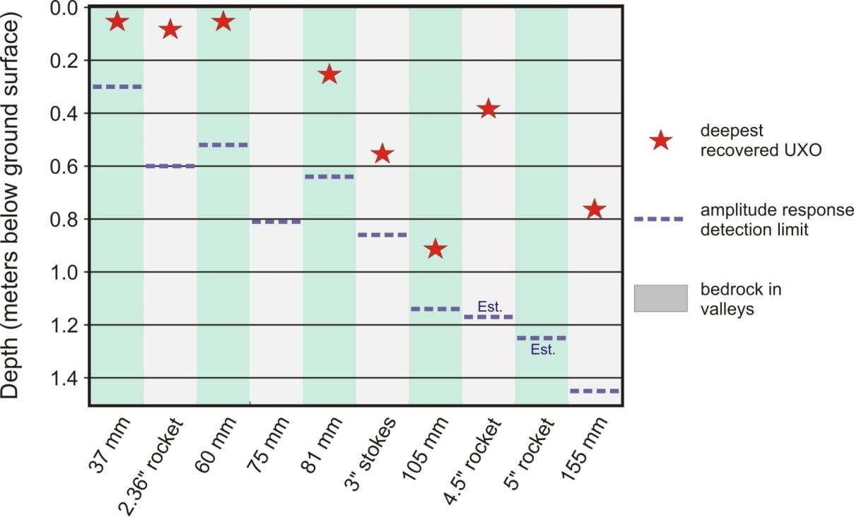
Background on MR Technologies
Along with intrusive data, these technologies advance the CSM (including the
vertical CSM)
(Jacobs 2023)
mm: millimeter(s)
LEGEND
Deepest recovered UXO
Amplitude response detection limit
Background on MR Technologies
Notes:
Though this CSM includes 75mm projectiles and 5-inch rockets, neither were recovered during Remedial Investigation. This may be the case at other/future sites. Point is that understanding depth of reliable detection and classification is important for all munitions types that may be at a site.

Slide 17
Presentation Overview
Introduction
Background on MR Technologies
SLAM Overview
One-Pass AGC Overview
Quality Requirements for MR Projects
Conclusions and Useful References
Notes:
With introduction to MR technologies complete, the next section will cover SLAM, a positioning technology (recall the top three concepts: Positioning, Detection, and Classification)

Slide 18
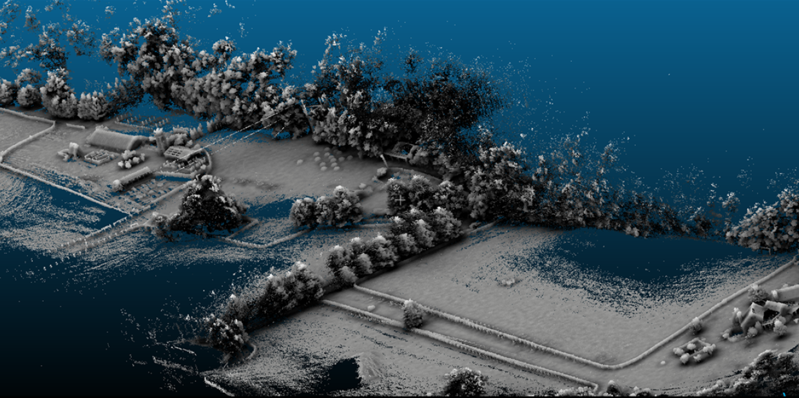
What is SLAM?
Simultaneous Localization and Mapping is a positioning technology
Scans with high precision LiDAR while in motion
Builds 3D model in real time and tracks position without GPS
Allows for high accuracy positional data in GPS-denied environments
Walk through
and scan environment
3D map is generated in real time
Mapped data used to create a 3D model
Accurate colorization and texture
LiDAR: light detection and ranging
(Jacobs 2023)
SLAM Overview
Notes:
“LiDAR” covers a variety of forms and applications. LiDAR may be used to see through vegetation (i.e., the last return). In this application, LiDAR is using first, second, and strongest return information to develop 3D model.

Slide 19
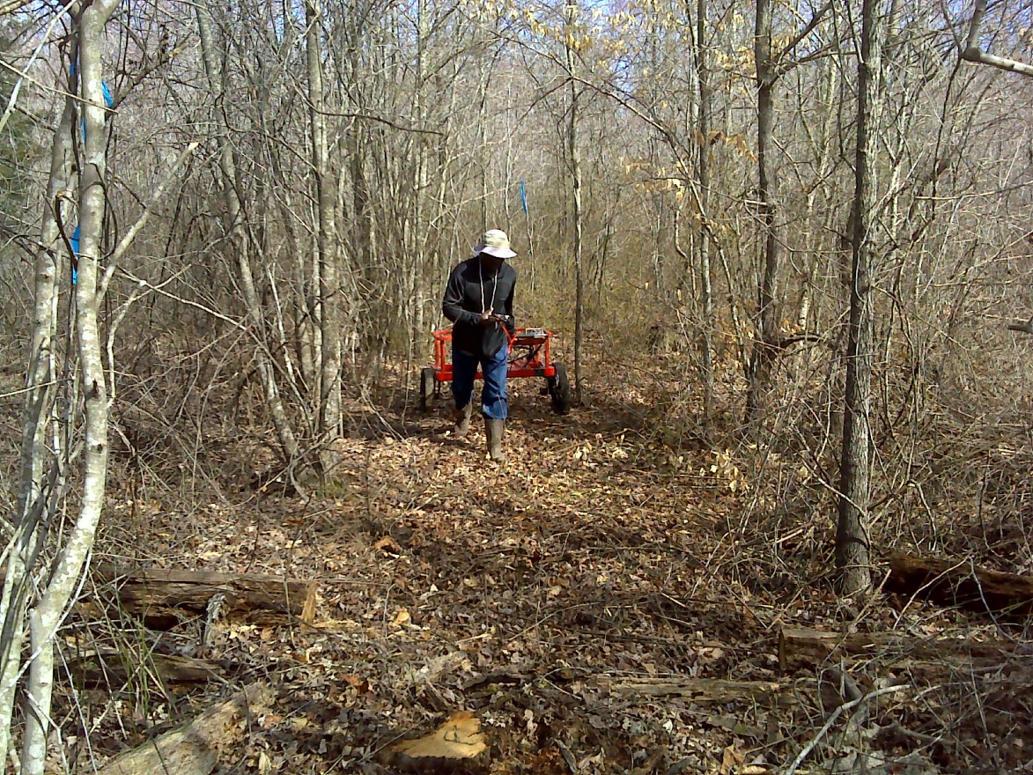
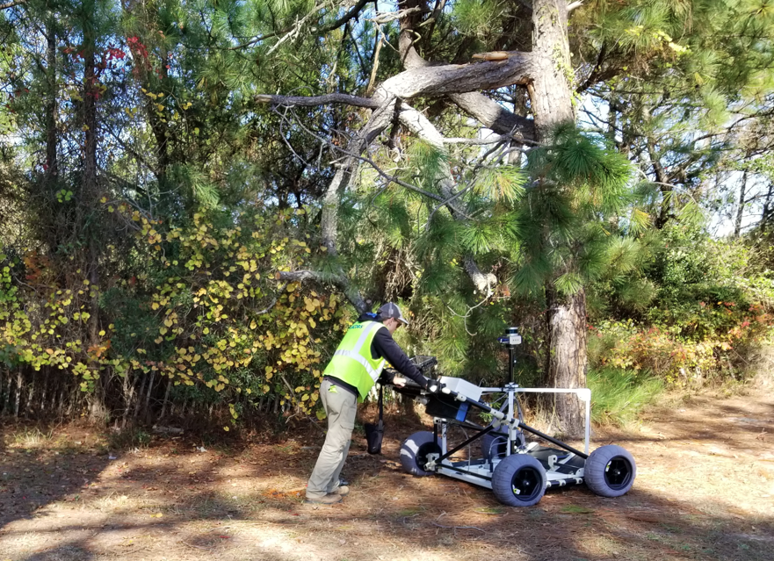
What is SLAM?
Simultaneous Localization and Mapping is a positioning technology
Scans with high precision LiDAR while in motion
Builds 3D model in real time and tracks position without GPS
Allows for high accuracy positional data in GPS-denied environments
For total coverage requirements in MRSs, GPS-compromised
is
GPS-denied!
MRS: munitions response site
(USACE 2012)
(Jacobs 2023)
SLAM Overview

Slide 20
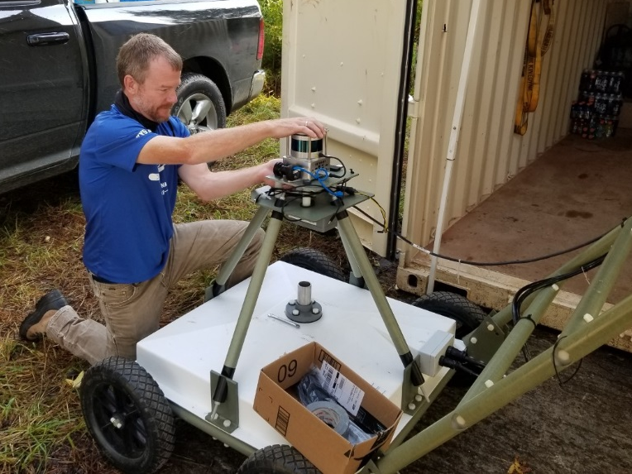
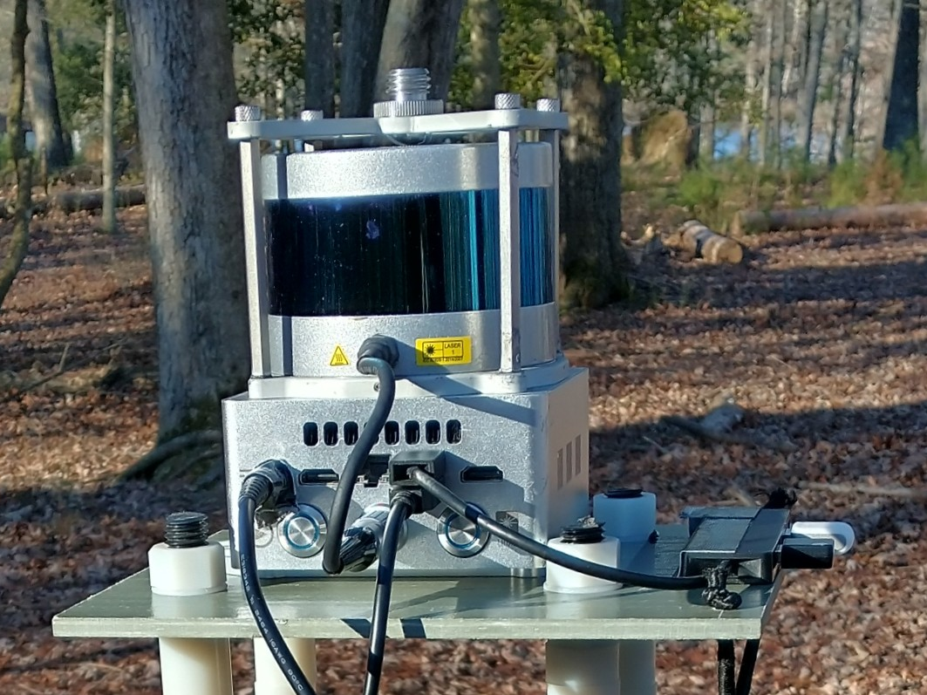
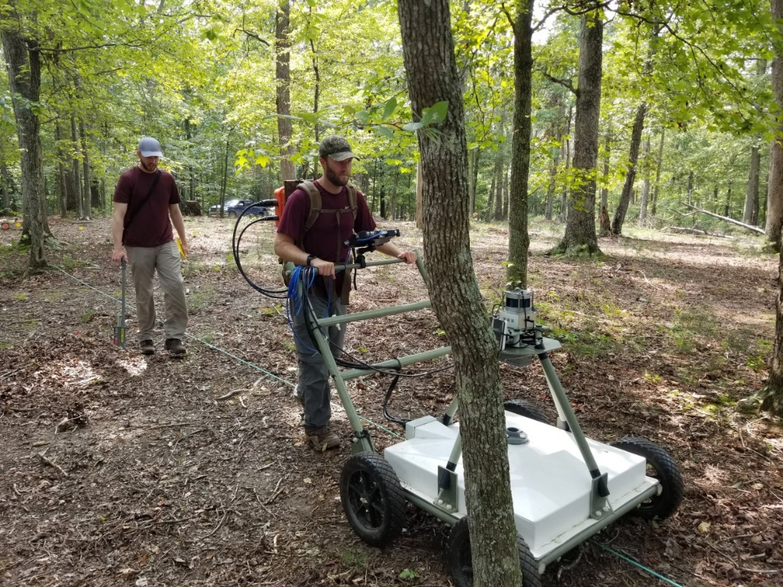
What is SLAM?
SLAM is a combination of hardware, software, and workflow to:
Develop a point cloud map
Establish the sensor’s location within it
Navigate through it
Output positional data in real time to a geophysical sensor
(Jacobs 2023)
SLAM Overview

Slide 21
What is SLAM?
  Back to the concept…
  How does this actually work?
SLAM Overview

Slide 22
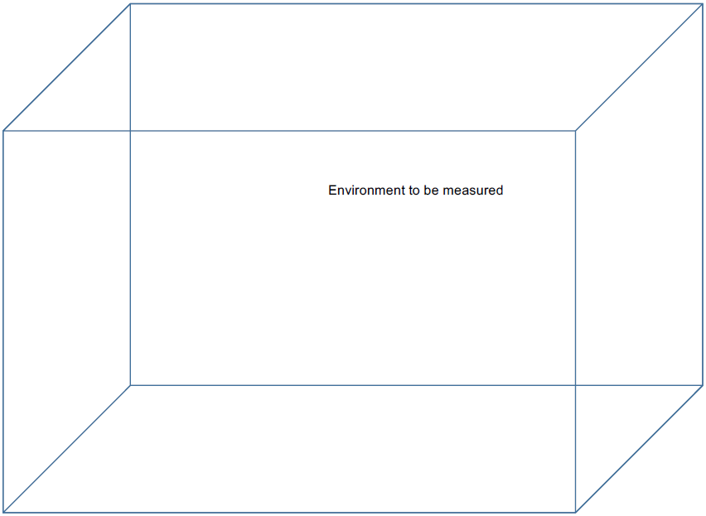
(Kaarta 2021)
SLAM Overview
Notes:
Context: consider this the room we are in. Bottom plane of cube is the ground surface, the room’s floor.

Slide 23
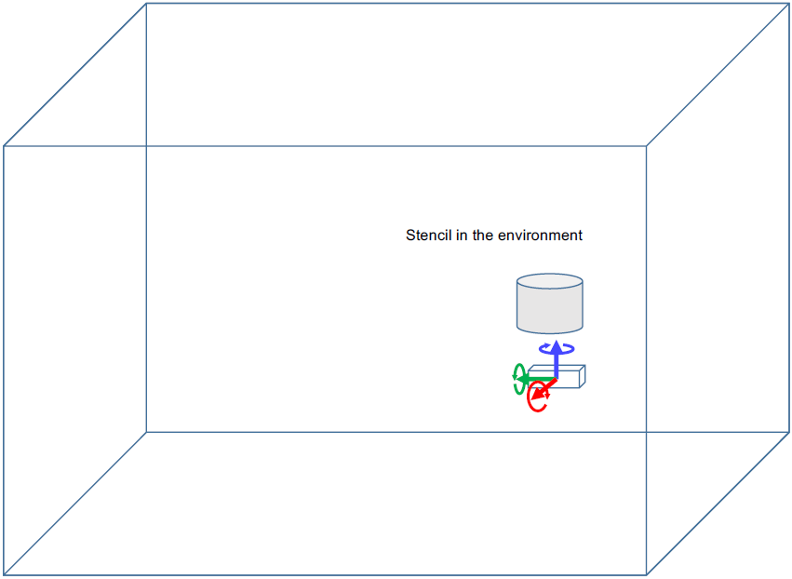
(Kaarta 2021)
SLAM Overview

Slide 24
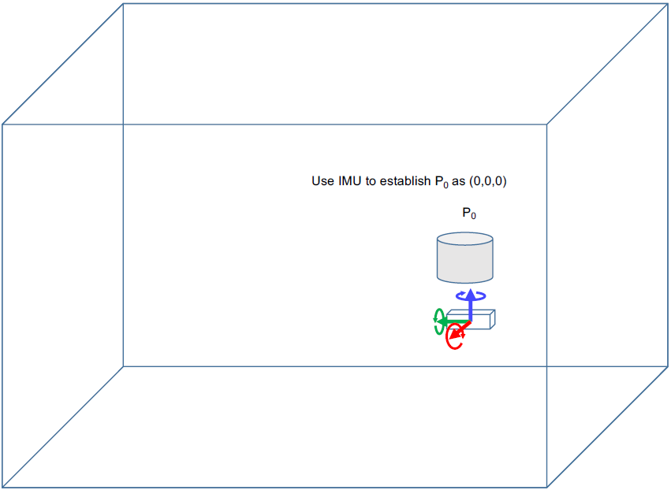
IMU: inertial measurement unit
(Kaarta 2021)
SLAM Overview
Notes:
IMU measures changes in acceleration on X,Y,Z axes, as well as angular velocity.

Slide 25
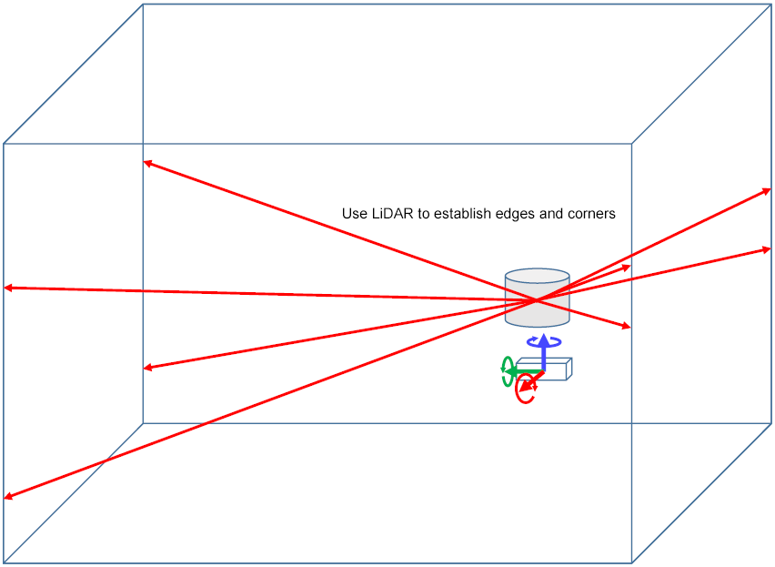
(Kaarta 2021)
SLAM Overview

Slide 26
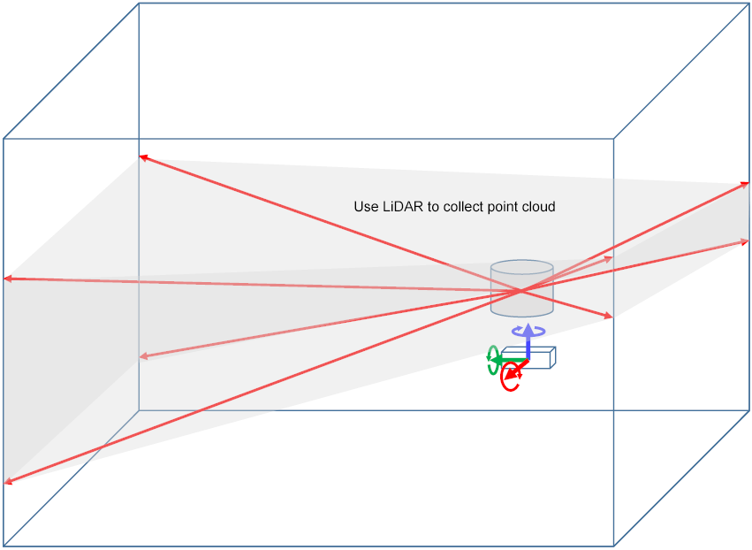
(Kaarta 2021)
SLAM Overview

Slide 27
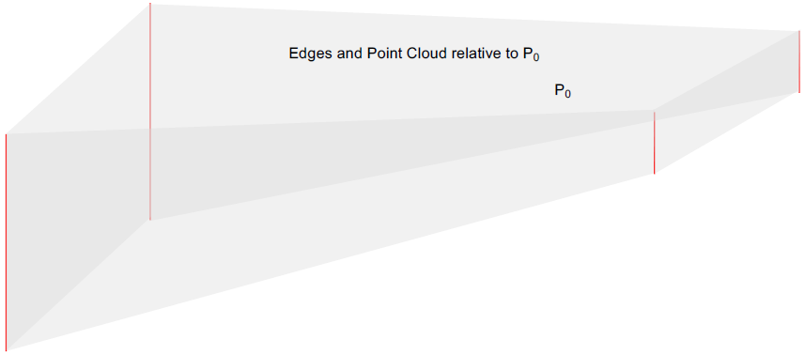
(Kaarta 2021)
SLAM Overview

Slide 28
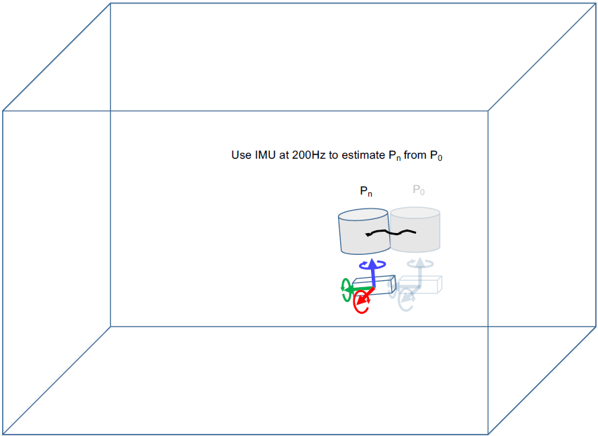
Hz: hertz
(Kaarta 2021)
SLAM Overview

Slide 29
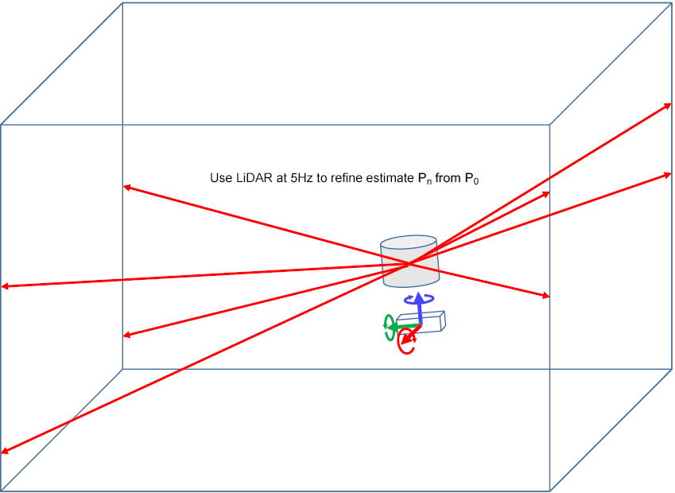
(Kaarta 2021)
SLAM Overview

Slide 30
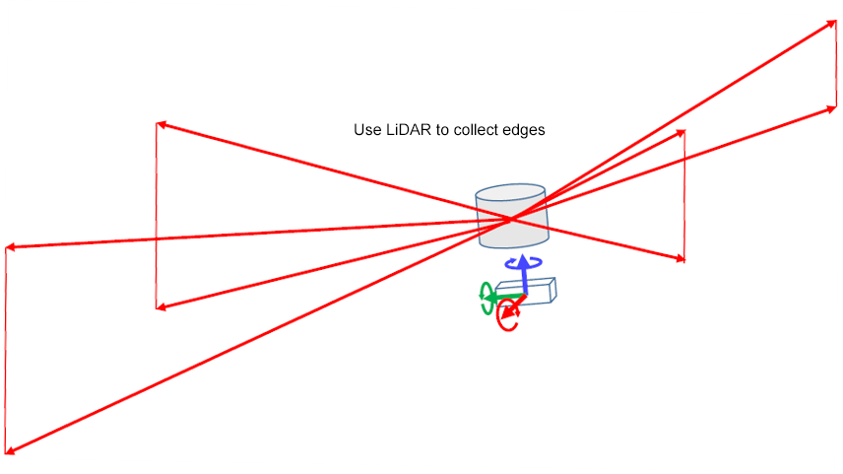
(Kaarta 2021)
SLAM Overview

Slide 31
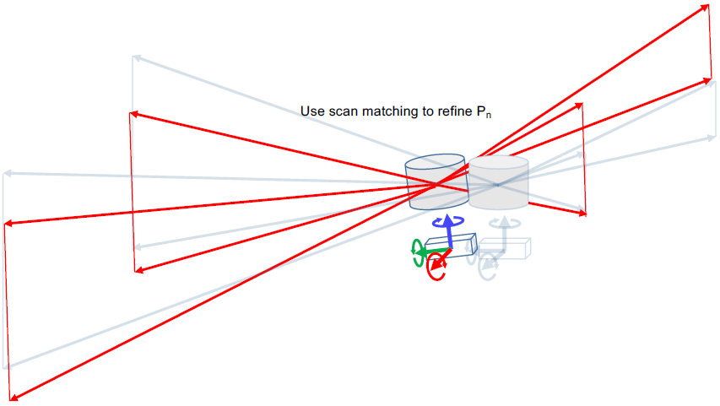
(Kaarta 2021)
SLAM Overview

Slide 32
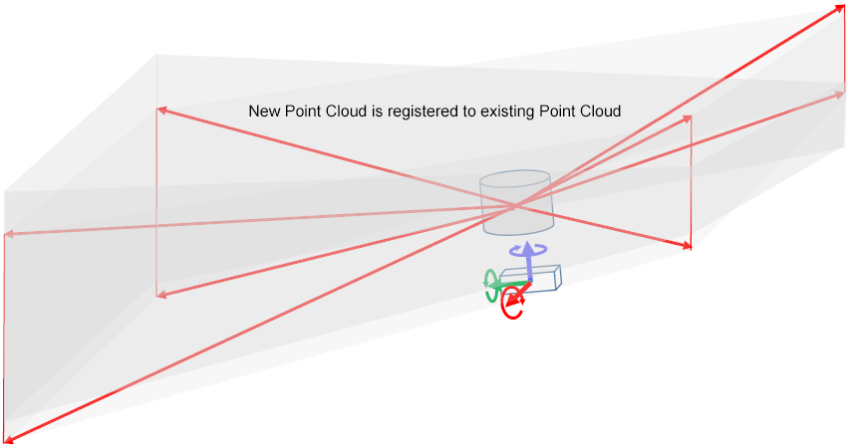
(Kaarta 2021)
SLAM Overview

Slide 33
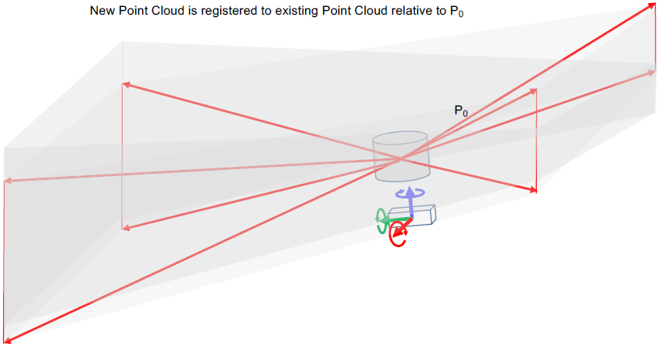
(Kaarta 2021)
SLAM Overview

Slide 34
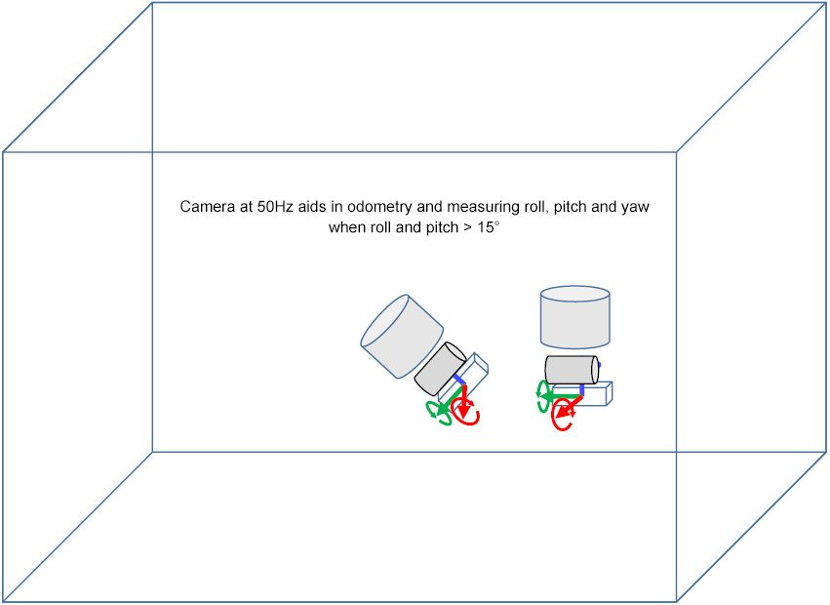
(Kaarta 2021)
SLAM Overview
Notes:
Accuracy is best when Roll, Pitch, and Yaw are less than 15 degrees. Consider using Camera Mode if using in steeper terrain.

Slide 35
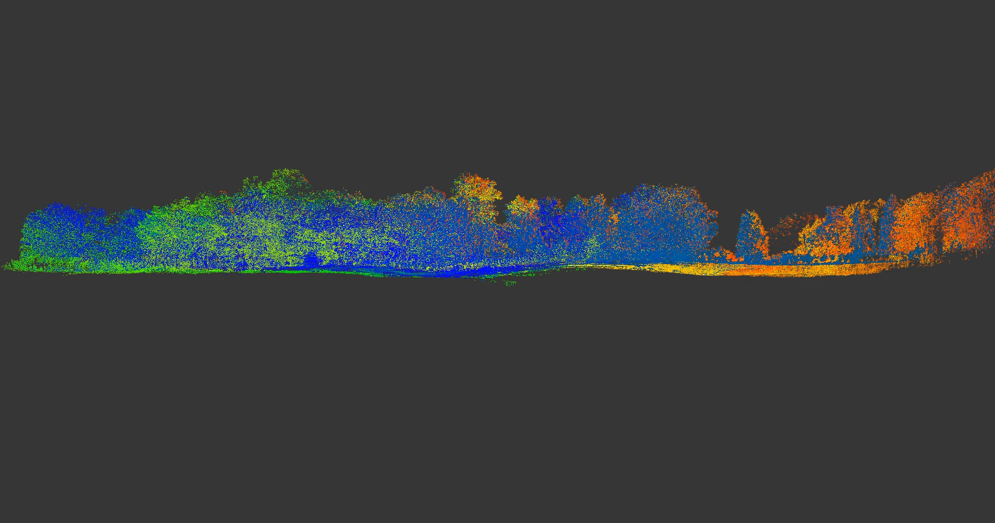
(Jacobs 2023)
SLAM Overview
Notes:
A point cloud map is created of the GPS-denied environment, then the SLAM sensor localizes and navigates within it, outputting positional data in real time to geophysical sensors.

Slide 36
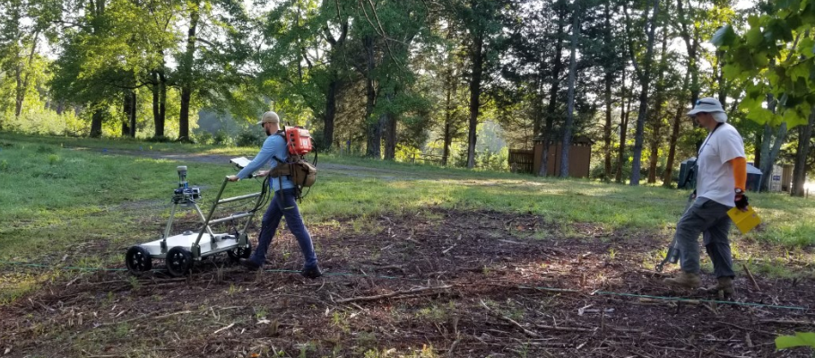

What is SLAM?
  Now we can take AGC (and other technologies) into the woods at our MRSs.
(Jacobs 2023)
SLAM Overview

Slide 37
Benefits of SLAM
  Now we can take AGC (and other technologies) into the woods at our MRSs.
This allows for more defensible data across an entire site and potential scope, schedule, and budget benefits:
  Accurate positional data allow for application of AGC
  AGC’s improved data quality adds assurance that investigative goals are met
  Allows for an even application of the investigation (compared to mixing AGC, fiducial DGM, and analog)
  Better RIs lead to better Remedial Designs/Remedial Actions and outcomes
  Generation of 3D model can be applied to the CSM (digital elevation model, and vertical distribution
  of MEC)
RI: Remedial Investigation
(Jacobs 2023)
SLAM Overview
Notes:
Positional information may be good from year to year (trees grow slowly). Refer to Camp Blanding lessons learned (USACE/Heaton, NAOC 2022).
Reduces need for Professional Land Surveyors because SLAM can be used for reacquisition (i.e., returning to a selected geophysical anomaly or source for intrusive investigation).

Slide 38
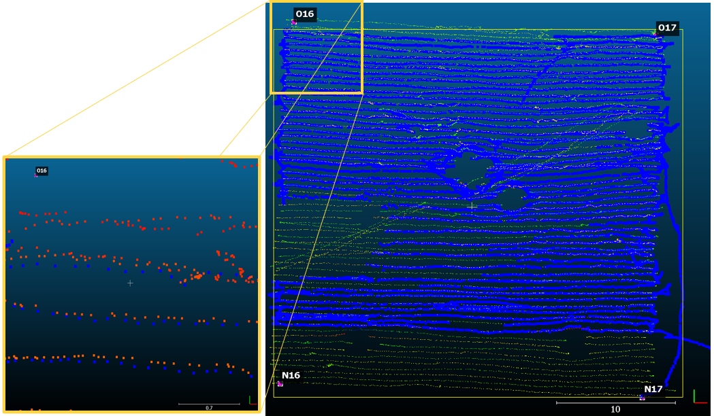
SLAM + AGC Case Study Results
2020 Pilot Study at Marine Corps Base Quantico
Dynamic MetalMapper 2x2 survey
  100-foot by 100-foot grids
  Data collection performed with concurrent RTK + SLAM
  positional data
    Blue: RTK-GPS positions
    Red/Green/Yellow:
    SLAM positions
  Typical RTK-to-SLAM
  difference: 0.07 meter
(Jacobs 2023)
SLAM Overview

Slide 39
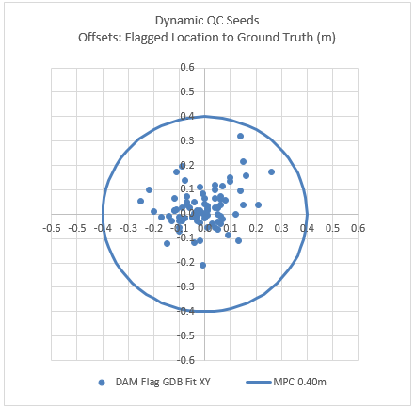
SLAM + AGC Case Study Results
2020 Pilot Study at Marine Corps Base Quantico
Dynamic MetalMapper 2x2 survey
  100-foot by 100-foot grids
  Data collection performed with concurrent RTK + SLAM
  positional data
Dynamic detection and positioning accuracy assessed through QC seeds
  Center of circle: QC seeds’ coordinates
  Blue dots: targets’ coordinates
DAM: dynamic acquisition mode
GDB: geophysical database
m: meter(s)
MPC: Measurement Performance Criteria (Pass/Fail)
QC: quality control
(Jacobs 2023)
SLAM Overview

Slide 40
SLAM Interactive:
Break for questions and comments

Slide 41
Presentation Overview
Introduction
Background on MR Technologies
SLAM Overview
One-Pass AGC Overview
Quality Requirements for MR Projects
Conclusions and Useful References

Slide 42
Basics of AGC Workflow
Detect-then-Cue Classification (‘Traditional’ AGC)
  An area is mapped dynamically to detect and target subsurface sources that may be MEC
    These targets are then visited with an AGC sensor to collect cued AGC data
      The cued AGC data are processed, and TOI/Non-TOI are classified
        TOI are intrusively investigated
One-Pass Classification
  An area is mapped dynamically to detect and target subsurface sources that may be MEC
    The dynamic AGC data are processed, and TOI/Non-TOI are classified
      TOI are intrusively investigated
  Q: Why would anyone detect then cue?
  A: Because we had no other option!*
TOI: target of interest
* opinion of presenter
One-Pass AGC Overview
Notes:
Note: Industry use of AGC developed largely through demonstrations in which accepted DGM methods (e.g., full coverage EM61 data+maps) were supplemented by cued AGC data collection and analyses. Initially, more data (and stationary data) collected over an unknown subsurface source were needed for reliable classification of the source(s).
Regulatory acceptance of, or familiarity with, cued AGC was supported via Interstate Technology and Regulatory Council documents and training. Department of Defense Advanced Geophysical Classification Accreditation Program has since recommended and ‘regulated’ the use of AGC.

Slide 43
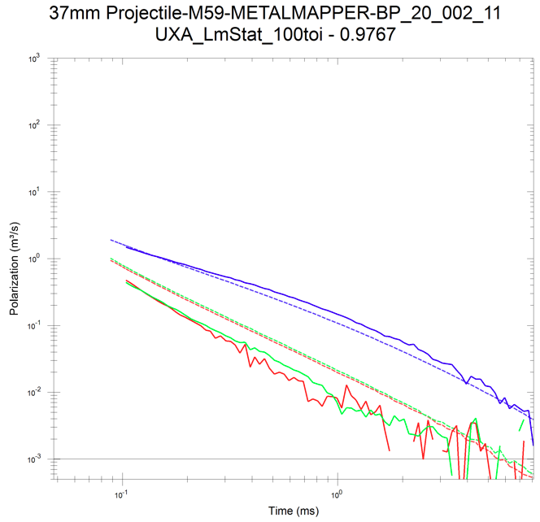
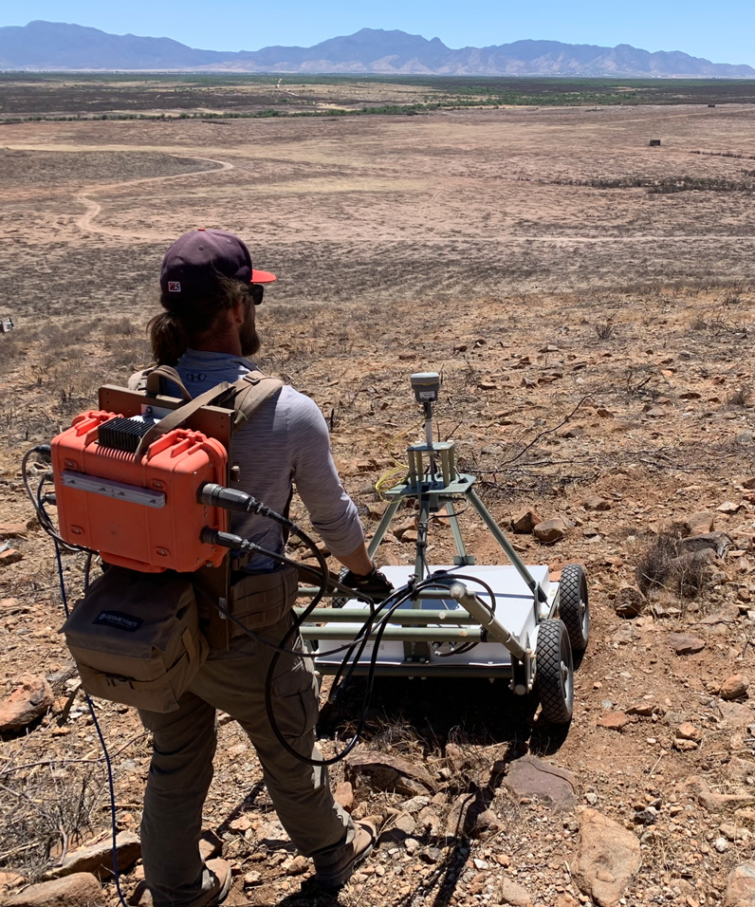
Cued AGC versus One-Pass AGC
Similarities:
Both provide a richer data set allowing for better guidance for intrusive investigation and follow-on remedial action alternatives
Both ultimately result in classification
of sources
Both reduce number of digs required by approximately same amount
Both have similar limits on classification in high-density situations
Both have several DAGCAP-validated sensors to choose from in varying
form factors
DAGCAP: DoD Advanced Geophysical Classification Program
(Jacobs 2023)
One-Pass AGC Overview

Slide 44
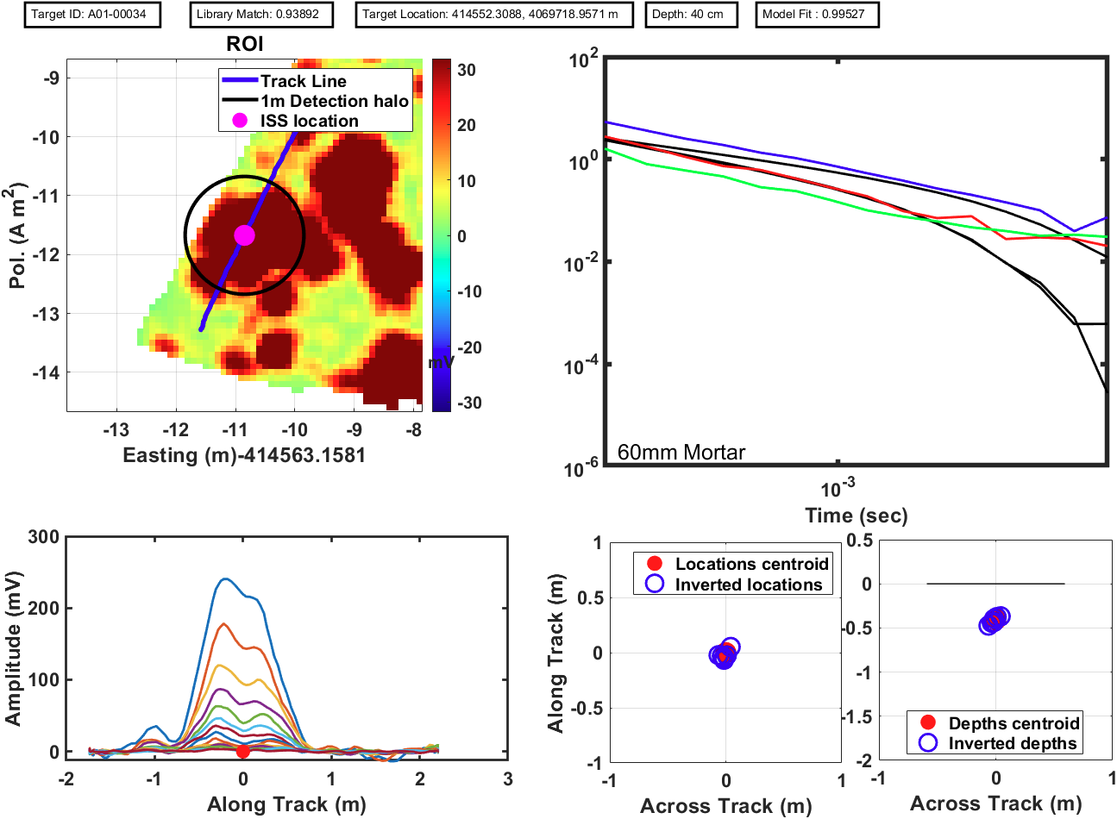
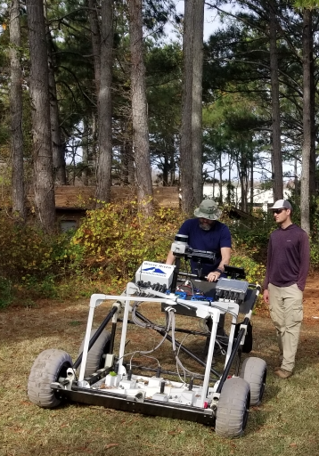
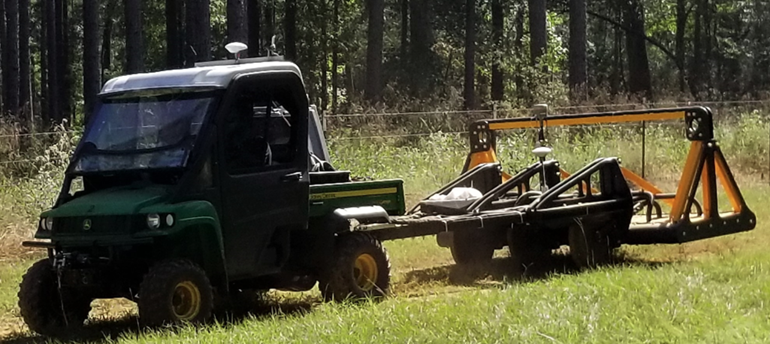
Cued AGC versus One-Pass AGC
Differences:
Detect-then-cue requires two phases of fieldwork
  Two field surveys, two rounds of processing,
  two rounds of QC, an extra step to report
One-Pass AGC is completed in a single
phase of fieldwork
  Single field survey, one round of processing,
  one round of QC, fewer steps to report
  Background leveling problems obviated
  Fewer steps for nonconformances
Industry has more experience with
detect-then-cue, but is rapidly gaining experience with one-pass
(Jacobs 2023)
One-Pass AGC Overview

Slide 45
Workflow: Cued versus One-Pass
Cued Workflow
One-Pass Workflow
Initial Planning/Initial TOI Library
Cued Survey
Intrusive Investigation
of TOI
Initial Planning/Initial TOI Library
Intrusive Investigation
of TOI
Initial Prioritized List
One-Pass AGC Survey
Detection Survey/Target Selection
Verification/Validation Digs
Verification/Validation Digs
Training Digs
Training Digs
Site-specific Library Finalized
Site-specific Library Finalized
Initial DUA
Final DUA
Final DUA
Prioritized Dig List
Prioritized Dig List
Cued AGC DUA
One-Pass DUA
DUA: data usability assessment
One-Pass AGC Overview
Notes:
Note: Many MR- and AGC-specific terms used.
Focus on the blue boxes – fewer steps. And the “Cued Survey” step may appear small in a flowchart, but as illustrated on Slide 51, can involve thousands of cued measurements and weeks of data collection and processing.

Slide 46
Workflow: Cued versus One-Pass
Cued Workflow
One-Pass Workflow
Initial Planning/Initial TOI Library
Cued Survey
Intrusive Investigation
of TOI
Initial Planning/Initial TOI Library
Intrusive Investigation
of TOI
Initial Prioritized List
One-Pass AGC Survey
Detection Survey/Target Selection
Verification/Validation Digs
Verification/Validation Digs
Training Digs
Training Digs
Site-specific Library Finalized
Site-specific Library Finalized
Initial DUA
Final DUA
Final DUA
Prioritized Dig List
Prioritized Dig List
Cued AGC DUA
One-Pass DUA
One-Pass AGC Overview
Notes:
Note: Many MR- and AGC-specific terms used.
Focus on the blue boxes – fewer steps. And the “Cued Survey” step may appear small in a flowchart, but as illustrated on Slide 51, can involve thousands of cued measurements and weeks of data collection and processing.

Slide 47
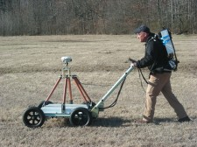
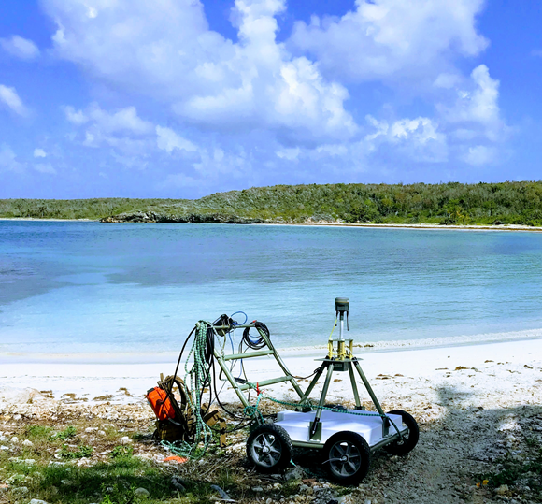

AGC Sensors Commercially Available
Detect-then-Cue AGC Sensors
TEMSENSE: used at MCB Quantico
  Firm vendor requirements for its use; very specific training
  Vendor is knowledgeable and generally responsive/supportive
  Currently only a single unit available for rent
  Good in similar environments to EM61
MetalMapper 2x2: used on many Navy and Army sites
  Known to have “issues,” difficulties on some sites
  Limited technical support at times
  Only a few units available for rent
  Good in similar environments to EM61
MPV: smaller, agile, person-portable
  Several for rent, have been in demand
  Good for sites with limited accessibility
TEMSENSE
(TEMSense 2023)
MM 2x2
MPV
MPV: Man Portable Vector
(Jacobs 2023)
(ESTCP)
One-Pass AGC Overview
Notes:
AGC sensor malfunctions and responsiveness of technical support need to be understood as potential factors to project schedules.
MetalMapper 2x2 “issues”: drift and background correction, the latter not due to MetalMapper itself, but rather the cued AGC approach.

Slide 48

AGC Sensors Commercially Available
APEX
One-Pass AGC Sensors
TEMSENSE
  Same sensor as for detect-then-cue
  Contractors and Government can process data using Geosoft
APEX: has been used at Naval Air Station Oceana
  Many units available for rent
  Many units have been sold into industry (i.e., >20)
  Good in similar environments to EM61
UltraTEM: has been used at Army installations
  Vendor also performs processing; a Geosoft option is “coming soon”
  Multiple form factors – Towed Array to person-portable
  Demonstrated success at large sites
  Person-portable validated, more agile form factors on the way
(Weston 2023)
UltraTEM
(Jacobs 2023)
One-Pass AGC Overview

Slide 49

AGC Project Spotlight –
Remedial Investigation at Dam Neck Annex
Moving Target Mortar Range – North
2010 SI → 2018 ESI → 2020 RI start → 2022 RI field start
Approximately 5 acres of RI
Tight schedule to minimize
disruptions to classroom building
AGC used for better data and to
focus intrusive investigation
GPS-denied areas, so SLAM
used for positional data
ESI: Expanded Site Inspection
SI: Site Inspection
(Jacobs 2023)
One-Pass AGC Overview

Slide 50


AGC Project Spotlight –
Remedial Investigation at Dam Neck Annex
Moving Target Mortar Range – North
2020 plan was to perform detect-then-cue
MetalMapper 2x2 undermined by sensor issues
(noise leading to QC fails, unusable data)
Team regrouped, selected one-pass
AGC for best outcome and for
classifying previous DGM targets
that were to be cued with AGC
Intrusive successfully completed
with minimal disruption to classroom
building users
(Jacobs 2023)
One-Pass AGC Overview

Slide 51



AGC Project Spotlight –
Remedial Investigation at Dam Neck Annex
Moving Target Mortar Range – North
Initial dynamic MetalMapper 2x2 data (where thought to be usable) indicates ~1,000 sources per acre would need cued AGC
Interim one-pass AGC results showing similar sources per acre, with good reductions without need for cued AGC
MetalMapper 2x2 AGC data
APEX one-pass AGC data over same area – good agreement between data sets
APEX data. Squares are detections, Xs are required digs.
(Jacobs 2023)
One-Pass AGC Overview

Slide 52
AGC Project Spotlight –
Remedial Investigation at Dam Neck Annex
Moving Target Mortar Range – North
Initial dynamic MetalMapper 2x2 data (where thought to be usable) indicates ~1,000 sources per acre would need cued AGC
Interim one-pass AGC results showing similar sources per acre, with good reductions without need for cued AGC
MetalMapper 2x2 AGC data
APEX one-pass AGC data over same area – good agreement between data sets
APEX data. Squares are detections, Xs are required digs.
Had 1,000 sources per acre that needed cued AGC, an additional
25 days (plus processing) would have been needed for a 5-acre site*
(Jacobs 2023)
One-Pass AGC Overview
Notes:
*Note: 25 extra field days is based on ~200 cued shots per day, and assumes all 5ac*1,000source/ac=5,000 sources would’ve been cued (i.e., no Saturated Response Areas, no suspected culture). This is unlikely in practice. However, the additional field effort for cued data collection, then the necessary processing of cued data, would certainly have added schedule and costs to this project.

Slide 53
One-Pass AGC:
Break for questions and comments

Slide 54
Presentation Overview
Introduction
Background on MR Technologies
SLAM Overview
One-Pass AGC Overview
Quality Requirements for MR Projects
Conclusions and Useful References

Slide 55
Quality Requirements for MR Projects
Quality Control (QC)
“QC is a product‐oriented technique or activity designed to evaluate a completed task or product. … The quality is determined by comparing a completed product against the requirements which were developed for that product.”
Quality Assurance (QA)
“QA is a process‐oriented technique that ensures all processes are defined and appropriate. QA reviews should focus on the process elements of a project, including a review of whether project requirements are defined at the proper level of detail.”
(NAVFAC EXWC, 2019)
Quality Requirements for MR Projects
Notes:
Generally,
QC: contractor’s check
QA: Government’s (or third-party designee’s) check

Slide 56

Quality Requirements for MR Projects
Quality Management
Quality Management:
Program activities involved with all aspects of quality
Personnel Requirements
Qualifications
Training
Project Planning
QAPPs
Work Plans
MQOs
Quality Assurance
Audit against planning docs
Third-party data
verification/validation
Validate results
Quality Assurance:
Audit project activities against planning documents
System Maintenance
Hardware upgrades
Software upgrades
SOPs
Quality Control:
Audit project against planned or standard measurement quality objectives
Quality Control
Verify data
Validate data
AGC demands greater quality management, plus accreditation
MQO: Measurement Quality Objective
QAPP: Quality Assurance Project Plan
SOP: standard operating procedure
(Jacobs 2023)
Quality Requirements for MR Projects

Slide 57
Quality Requirements for MR Projects
Ensure quality of data being collected
Ensure that collected data and derived products are sufficient to support conclusions
Document QA/QC findings so team can be assured of quality of results
Quality Requirements for MR Projects
Notes:
Note: documentation is critical to QA/QC.

Slide 58


Quality Requirements for MR Projects
Intergovernmental
Data
Quality
Task
Force
QAPP toolkits for
  RIs (April 2020)
  Remedial Actions (March 2023)
More than just requirements for sensors and similar
(DoD 2020, 2023)
Quality Requirements for MR Projects
Notes:
They’re toolkits! Not templates. There is room for some healthy ribbing on contractors’ use as a template.
QAPP toolkit is STARTING POINT for a QAPP.
QAPPs are more than requirements for technologies, sensors, and similar.
Not all aspects of the toolkits’ sample project apply to every site. The toolkit sample projects are intended to be complex examples to help with planning and development of a project’s QAPP.

Slide 59
Presentation Overview
Introduction
Background on MR Technologies
SLAM Overview
One-Pass AGC Overview
Quality Requirements for MR Projects
Conclusions and Useful References

Slide 60
Conclusions
SLAM is available for use in GPS-denied environments, allowing use of AGC sensors and development of rich CSMs
AGC is moving toward one-pass method, but exceptions will persist
QAPPs are available (and necessary) to ensure quality outcomes for MR projects
Conclusions and Useful References

Slide 61
Useful References
DENIX site: https://www.denix.osd.mil/mmrp/
DENIX’s AGC site:
https://www.denix.osd.mil/mmrp/advanced-geophysical-classification-accreditation-and-other-tools/
Interstate Technology and Regulatory Council guidance on QA/QC of AGC: https://qcmr-1.itrcweb.org/
Navy's Basic and Advanced Munitions Response Site Management Courses: https://www.netc.navy.mil/Commands/Center-for-Seabees-and-Facilities-Engineering/Naval-Civil-Engineer-Corps-Officers-School/Courses/Environmental-Restoration/
Navy’s Guidance for Munitions Response Remedial Investigations and Feasibility Studies: Technical Report WEB‐NAVFAC‐EXWC‐EV‐1906, June 2019, Munitions Response Remedial Investigation/Feasibility Study Guidance
DENIX: DoD Environment, Safety, and Occupational Health Network and Information Exchange
Conclusions and Useful References

Slide 62
Points of Contact
Presenter
Steve Saville
Jacobs
Steve.Saville@Jacobs.com
Topic Champions
Alexandria Hairabedian
NAVFAC EXWC
Alexandria.M.Hairabedian.civ@US.Navy.mil
Bryan Harre
NAVFAC EXWC
Bryan.L.Harre.civ@US.Navy.mil
Conclusions and Useful References

Slide 63
Questions

Slide 64
Backup Slides

Slide 65
Background on MR Technologies
Summary of MR technologies and their objectives
  Classification – focus on the munitions
    As we covered, most subsurface metallic objects are not munitions related
    AGC, uses multi-axis EM sensors to collect a tremendous amount of data, then software to invert data to identify source(s) (that is, tangible objects) most likely to have caused the measured data
EM: electromagnetic
Background on MR Technologies
Notes:
Inversion = mathematical process to identify the cause(s) behind measured data

Slide 66
Background on MR Technologies
Summary of MR technologies and their objectives
  Classification – focus on the munitions
    As we covered, most subsurface metallic objects are not munitions related
    AGC, uses multi-axis EM sensors to collect a tremendous amount of data, then software to invert data to identify source(s) (that is, tangible objects) most likely to have caused the measured data
Background on MR Technologies
Notes:
Inversion=mathematical process to identify the cause(s) behind measured data

Slide 67
SLAM + AGC Case Study Results
2020 Pilot Study at Marine Corps Base Quantico
Left: Concurrent RTK + SLAM positional data
Blue dots: RTK-GPS positions Red/Green/Yellow dots: SLAM positions
Typical RTK-to-SLAM offset ~7 centimeters
Right: Distance between QC seed location (center of circle) and targeted locations (blue circles)
DAM: dynamic data
GDB: database
m: meter(s)
MPC: Measurement Performance Criteria (Pass/Fail)
QC: quality control
SLAM Overview

